Slide 1

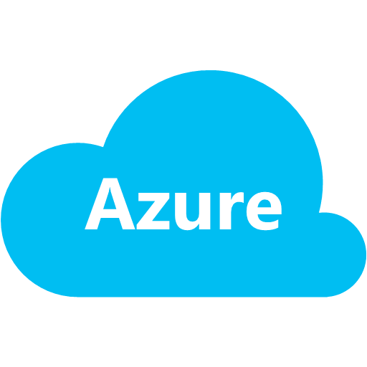

web sites
secrets, exposed!

Slide 2



nik molnar
nikmd23

Notes:
Introduce myself:
Azure Insider
ASP.NET Insider
MVP

Slide 3

I
AZURE WEB SITES
Developer focused Platform As A Service

Notes:
Azure is huge, so today we’re only going to focus on Azure Web Sites and some of the nooks and crannies of that
Web Sites is Microsoft’s PAAS offering aimed at developers. Azure web sites is different than Azure Web Roles, which you may have heard of.
Let’s set up a site real quick.
DEMO: Deploy Full Stack Web Perf site/repo

Slide 4

AZURE WEB SITES
comparison
WEB ROLE
Elevated Startup Scripts
RDP into VM
Network Isolation
Virtual Networks
Dedicated IP Address
ACL-Restricted Endpoints
Any TCP/UDP Port
WEB SITE
Near-Instant Deployment
Rollbacks
Continuous Deployment
Application Gallery
Web Jobs
Content Backup
Notes:
Web Roles have some advantages over Web Sites, particularly of interest to enterprise users.
Most developers who are used to running everything through source control will enjoy Web Sites more.

Slide 5



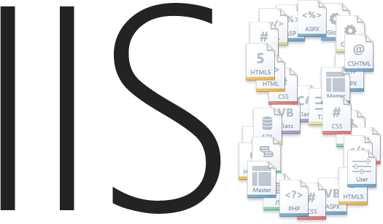
AZURE WEB SITES
architecture
ARR
KUDU

Notes:
MAWS isn’t anything special, really.
It’s basically Windows, IIS and .NET, along with an open source project named Kudu.
DEMO: connecting via inetmgr
Kudu does a few things, most notably getting changes from many different source control systems, building and deploying sites.
I like to think of it as a very basic CI server

Slide 6


II
b
KUDU
The magic behind Microsoft Azure Web Sites
Notes:
Kudu has a single tenant architecture, as opposed to a typical multi-tenant service architecture. Kudu service is a 'buddy site' to the users real Azure site. The main difference is that the Kudu site is being given access to the files of the real site, allowing it to publish to it.
The Kudu site runs in the same sandbox as the real site, so the only thing it can harm is the site itself. Furthermore, the Kudu site shares the same quotas as the site. (CPU/RAM/Disk used by the Kudu service are counted toward the site's quota)
Kudu site is authenticated by http basic auth, which by default the real site is not authenticated
Kudu runs in the same process as the site, but the only thing that really 'connects' the Kudu site to the real site is the file system, and that works regardless of what process or machine they each run on.

Slide 7
DEPLOYMENT
workflow + settings
Scm
Acquire source from source control system

Slide 8
DEPLOYMENT
workflow + settings
Scm
Build
Acquire source from source control system
Compile binary assets (if applicable)

Notes:
Build for .NET.
Very minimal/no step for Node apps

Slide 9
DEPLOYMENT
workflow + settings
Scm
Build
Copy
Acquire source from source control system
Compile binary assets (if applicable)
Deploy assets to wwwroot directory

Notes:
Source or compiled binaries get copied

Slide 10

DEPLOYMENT
workflow + settings
Scm
Build
Copy
Post
Acquire source from source control system
Compile binary assets (if applicable)
Deploy assets to wwwroot directory
Execute action hook script after successful deployment


Hook

Notes:
DEMO: Using a Post action in site\deployments\tools\PostDeploymentActions
DEMO: Using a hook from zapier.com to twitter

Slide 11

DEPLOYMENT
workflow + settings
Scm
Build
Copy
Post
Acquire source from source control system
Compile binary assets (if applicable)
Deploy assets to wwwroot directory
Execute action hook script after successful deployment


AppSettings
.ini File
.cmd File
Hook
SCM_REPOSITORY_PATH SCM_NO_REPOSITORY SCM_TARGET_PATH
PROJECT
...
SCM_BUILD_ARGS
SCM_SCRIPT_GENERATOR_ARGS
SCM_DISABLE_SUBMODULES
SCM_USE_SHALLOW_CLONE
SCM_POST_DEPLOYMENT_ACTIONS_PATH
DIAGNOSTICS_*
...
azure site deploymentscript

Notes:
Install Node CLI
Use Cases for AppSettings changes:
In place deployment
In place deployment w/ readonly history
Deploy from subfolder of repo
Deploy to a subfolder of wwwroot
DEMO: creating a deploymentscript
DEMO: Show .ini file and the command setting

Slide 12
DEPLOYMENT
workflow + settings
echo Building test project
"%MSBUILD_PATH%" "%DEPLOYMENT_SOURCE%\source\Tests\Tests.csproj“
IF !ERRORLEVEL! NEQ 0 goto error
echo Running tests
cd %DEPLOYMENT_SOURCE%\packages\xunit.runners*\tools
xunit.console.clr4 ..\..\..\source\Tests\bin\Debug\Tests.dll
IF !ERRORLEVEL! NEQ 0 goto error
----
:: 3. KuduSync

Slide 13
DEBUGGING
*.scm.azurewebsites.net


{}

Environment
Console
Api
Extensions
Listing of useful configuration and environmental information.
Cmd.exe and PowerShell console on the remote machine.
RESTful API endpoints and WebHook configuration.
Administrative extensions in an Azure authorized space.

Notes:
DEMO: Show off .SCM site

Slide 14

AUTHENTICATION
deployment credentials
ü

USER CREDENTIALS
User generated, tied directly to a Microsoft account, not a given Web Site. Do not share.
ü
SITE CREDENTIALS
Auto generated, following $site-name convention. Specific to a given site, meant to share with tooling via publish profile.
ü
MICROSOFT ACCOUNT
Global across all Microsoft properties, including the Azure portal and now the Kudu SCM site.

Slide 15

(
CONFIGURATION

III
Infinite flexibility.
Comfortable model.

Slide 16
CONFIGURATION
hierarchy
app host
XDT
root web
machine
web
XDT
final
azure overrides

Notes:
Azure overrides are a great way to deal with secrets you don’t want in source control
DEMO: Serving .svg file from site/wwwroot with .xdt in site/

Slide 17
XDT TRANSFORM
.svg configuration
<configuration xmlns:xdt="http://schemas.microsoft.com/XML-Document-Transform">
<system.webServer>
<staticContent>
<mimeMap fileExtension=".svg" mimeType="image/svg+xml" xdt:Transform="Insert" />
</staticContent>
<httpCompression>
<dynamicTypes>
<add mimeType="image/svg+xml" enabled="true" xdt:Transform="Insert" />
</dynamicTypes>
</httpCompression>
</system.webServer>
</configuration>
Notes:
Quickly cover the xdt file we just used

Slide 18
XDT TRANSFORM
increase queueLength
<configuration xmlns:xdt="http://schemas.microsoft.com/XML-Document-Transform">
<system.applicationHost>
<applicationPools>
<add name="%XDT_SITENAME%" queueLength="5000"
xdt:Locator="Match(name)" xdt:Transform="SetAttributes(queueLength)">
</add>
</applicationPools>
</system.applicationHost>
</configuration>
Notes:
You could also do something like increase the queueLength on IIS for waiting requests
What’s interesting about this example is the use of the %XDT_SITENAME% token.

Slide 19
XDT TRANSFORM
increase queueLength
<configuration xmlns:xdt="http://schemas.microsoft.com/XML-Document-Transform">
<system.applicationHost>
<applicationPools>
<add name="%XDT_SITENAME%" queueLength="5000"
xdt:Locator="Match(name)" xdt:Transform="SetAttributes(queueLength)">
</add>
</applicationPools>
</system.applicationHost>
</configuration>
Env Vars
XDT_SITENAME
XDT_SCMSITENAME
XDT_APPPOOLNAME
XDT_EXTENSIONPATH
HOME
Notes:
Kudu replaces several tokens in order for you to create reusable transforms across many sites

Slide 20
XDT TRANSFORM
add site extension
<configuration xmlns:xdt="http://schemas.microsoft.com/XML-Document-Transform">
<system.applicationHost>
<sites>
<site name="%XDT_SCMSITENAME%" xdt:Locator="Match(name)">
<application path="/{extension-name}" xdt:Locator="Match(path)" xdt:Transform="Remove" />
<application path="/{extension-name}" applicationPool="%XDT_APPPOOLNAME%" xdt:Transform="Insert">
<virtualDirectory path="/" physicalPath="%XDT_EXTENSIONPATH%" />
</application>
</site>
</sites>
</system.applicationHost>
</configuration>
Notes:
This allows us to add additional applications – which gives us all the

Slide 21
SITE EXTENSIONS
*.scm.azurewebsites.net
USER SITE
vs online
web deploy
uploaded
installed

kudu
web jobs
SITE EXTENSIONS
AZURE WEB SITE

Notes:
DEMO: Upload Hero to SiteExtensions/Hero

Slide 22

IV
LOAD BALANCING
Application Request Routing

Slide 23
APPLICATION REQUEST ROUTING
load balancer
WFE 1
client
ARR
WFE 2
WFE N

Slide 24
APPLICATION REQUEST ROUTING
sticky sessions
<system.webServer>
<httpProtocol>
<customHeaders>
<add name="Arr-Disable-Session-Affinity" value="true" />
</customHeaders>
</httpProtocol>
</system.webServer>

Slide 25
APPLICATION REQUEST ROUTING
sticky sessions
C:\> azure site show {site} info: Executing command site show info: Showing details for site + Getting site instances information ...
data: Instance Id data: ------------------------ data: ffd1675bc45d4e5df585db5… data: b2341a09060538ad4d9c801…
GET http://{site}.azurewebsites.net/ HTTP/1.1
Host: {site}.azurewebsites.net
...
Cookie: ARRAffinity=ffd1675bc45d4e5df585db5…


Slide 26


QUESTIONS
?
http://bit.ly/waws-secrets
nikmd23

Notes:
This is what I wanted to show you.
In the end the secret is that most of what you can exploit with IIS, works with Azure WebSites – but have been presented in a nicer way.
Kudu also unlocks a nice decent amount of power.

Slide 27
THANK
YOU
FOR COMING

@nikmd23

